Slide 1


Guidelines for Land Clearing
Presented By:
SLC Environmental Resources Department
Notes:
Welcome to Guidelines for Land Clearing presented by St Lucie County Environmental Resources Department. This short presentation is intended to guide you through the rules and regulations governing the removal of vegetation within unicorporated St. Lucie County.

Slide 2
When Do I Need to Fill Out a Notice of Vegetation Removal Application?
According to the SLC Land Development Code Section 6.00.03.A:
“No person shall conduct any vegetation removal activities from or on any lot or parcel of land or portion thereof in the unincorporated area of St. Lucie county without first obtaining a Notice of Vegetation Removal”
In other words anytime you are removing vegetation that is not:
  Maintenance of a government park or preserve
  Existing “bona fide agricultural” activities
  Routine landscape maintenance
Notes:
So when do you need to fill out a notice of vegetation removal application? The short answer to that question is anytime you are removing vegetation in unicorporated St. Lucie County. The three exceptions to this are maintenance of government park or preserves, existing bona fide agriculture as defined by the St. Lucie County Property Appraiser not including new agricultural operations, and routine landscaping such as mowing, trimming, or replacing dead landscaping material.

Slide 3


Why Is This Necessary ?
Land Development Code Compliance
Gives staff the opportunity to educate the land owner on the native plants existing and the benefit of preserving existing vegetation
Allows staff to inspect the property for listed species and wetlands
Notes:
This process is necessary to comply with our land development code regulations which were designed to protect and preserve native vegetation and habitats within the county. In addition the process allows us to educate property owners on the importance of native vegetation and the associated benefits with preserving this vegetation. Finally the process allows staff to inspect the property for other environmental issues such as listed species and/or wetlands.

Slide 4

Where Do I Get The Application?
Vegetation Removal Applications may be obtained online at:
http://www.stlucieco.org/erd/
Hard copies may be requested from SLC Environmental Resources Department
Mail To:
2300 Virginia Ave.
Ft. Pierce, Florida 34982
Fax: 772-462-1684
E-mail: environmentalresources@stlucieco.org
Notes:
Applications can be obtained online, in our office located at 2300 Virginia ave in fort pierce, or can be emailed or faxed upon request.

Slide 5
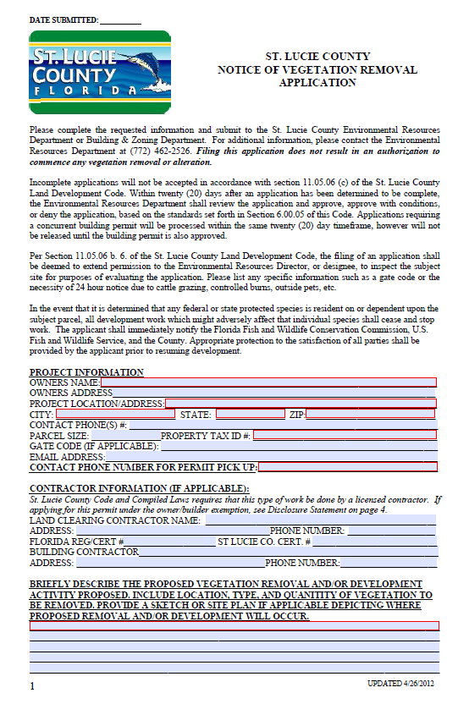
Filling Out The Application
Per SLC LDC 11.05.06C:
All sections of the application must be filled out.
INCOMPLETE APPLICATIONS WILL NOT BE PROCESSED AND WILL BE RETURNED TO THE APPLICANT
Be sure to include:
  Correct contact information
  Notarized signature the last page
  A brief description of the proposed
  development activity
Notes:
Please be sure to fill out the application completely. Include any pertinent information such as gate access codes, required call aheads for dangerous animals, and accurate contact information. All applications must be notarized however we have a notary in our office who can notarize your application free of charge.

Slide 6
Filling Out The Application
Be sure to clearly identify what vegetation you plan on removing either in the field or on a plan attached to the application
Clearly identify the reason for the requested vegetation removal (Is it a hazard? Is it in the way of proposed construction? Is it an exotic invasive species?)
Notes:
Be sure to clearly identify what vegetation you plan on removing either in the field or on a plan attached to the application
Clearly identify the reason for the requested vegetation removal (Is it a hazard? Is it in the way of proposed construction? Is it an exotic invasive species?)

Slide 7

License Contractors
Per SLC CODE OF ORDINANCE SECTION 10 Article II:
10-19 It is the intent of the board of county commissioners to protect the health, safety, and welfare of the residents of the county through the regulation of the construction and home improvement industries.
10-56 Certificate of Competency Requirement: Any person, other than a certified contractor as defined in this article, desiring to engage in or work at the business or occupation of contractor, as defined in this article, in the unincorporated areas of the county shall not engage in said occupation or business until such person has first obtained a certificate of competency as provided in this division, and has registered in the proper classification with the state department of business and professional regulation pursuant to the provisions of F.S. Ch. 489
A Land Clearing Contractor's scope of services is limited to the clearing of land of vegetation, the grubbing of roots, the removal of surface debris and leveling of the surface lands incidental to the land clearing action.
Notes:
State law requires land clearing to be done by licensed contractors. The property owner may apply for a permit under an exemption to that law. The exemption allows the owner to act as their own contractor with certain restrictions even though they do not have a license. Please contact the Contractor Licensing Department at 772-462-1672 with questions regarding licensing.

Slide 8

How Long Will It Take To
Process My Application?
Per SLC LDC Section 11.05.06C:
A determination of completeness shall be performed within two (2) working days of submission
While staff always strives to review and process applications as quickly as possible, by code staff has up to twenty (20) days from receipt to review and process the application
If your application is submitted in conjunction with a building permit you will receive a phone call to pick up your permit/exemption when your entire permit package is ready to be picked up. All permits/exemptions associated with building permits are issued concurrently with the building permit.
If your application is not associated with a building permit you will receive a phone call or email directly from the Environmental Resources Department when your permit/exemption is ready to be picked up.
Notes:
At time of intake the application will be reviewed for completeness, Incomplete applications will be returned. While staff always strives to review and process applications as quickly as possible, by code staff has up to twenty (20) days from receipt to review and process the application. If your application is submitted in conjunction with a building permit you will receive a phone call to pick up your permit/exemption when your entire permit package is ready to be picked up. All permits/exemptions associated with building permits are issued concurrently with the building permit. If your application is not associated with a building permit you will receive a phone call or email directly from the Environmental Resources Department when your permit/exemption is ready to be picked up.

Slide 9
Approval Criteria For Vegetation Removal Permits
According to SLC Land Development Code Section 6.00.05(A), the applicant must demonstrate that the removal of the native vegetation is the minimum necessary in order to implement a Final Development Order and that reasonable efforts have been made to microsite impervious surfaces to protect native vegetation and provide details supporting why preservation of the existing native vegetation is not practically feasible and prevents the reasonable development of the site.
Notes:
In order to get approval of your vegetation removal permit the applicant must demonstrate that avoidance and minimization of impacts to native vegetation have been completed to the greatest extent feasible.

Slide 10
EXEMPTIONS
Several vegetation removal activities qualify for an exemption Vegetation Removal Permit (exempts the applicant from mitigation requirements)
A NOTICE OF VEGETATION REMOVAL MUST STILL BE SUBMITTED AND APPROVED BY ERD AS A QUALIFYING EXEMPTION
Notes:
There are several activities that qualify as an exemption under S. Lucie County Code however please note these exemptions still require an application to be submitted and an exemption to be issued. The “exemption” only exempts the applicant from mitigation requirements not for obtaining a permit.

Slide 11
The Following Activities Qualify for Exemptions:
Minimal removal of vegetation necessary for a path not to exceed four feet in width to provide physical access
Minimal removal of vegetation necessary for a vehicular access path not to exceed ten feet in width as necessary for soil boring test provided work is performed by a Florida registered surveyor or engineer
Removal of vegetation in an existing utility easement, drainage easement, storm water management tract or facility, or right-of-way provided such work is done by or under the control of the operating unit of local, state, or federal government, utility company
Notes:
Here are a few examples of activities that qualify for exemptions.
Minimum removal of vegetation for a path not to exceed 4 ft for physical access
Minimal removal in order to perform soil boring test
Removal of vegetation within an existing utility easement, drainage easement, or ROW

Slide 12

Exemptions Continued…
Removal of vegetation which has been determined to be a safety hazard, destroyed or damaged beyond saving by natural causes
Removal of vegetation upon any detached single family residential lot or parcel of land having an area of one acres or less except removal of protected vegetation or native vegetation 24 inches or greater DBH (diameter at breast height)
Removal or alteration of any non-native vegetation
Notes:
Other exemptions include hazardous vegetation removal, removal of vegetation on a single family lot less than one acres (as long as nothing is greater than 24 inches dbh), and removal of any non-native vegetation

Slide 13
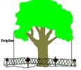
Vegetation Protection Standards During the Duration of an Approved Notice of Vegetation Removal
Protective barriers constructed of metal, wood, safety fencing or other durable material must be placed and maintained around the perimeter of protected vegetation, wetlands, shoreline buffer zones, and as otherwise specified in special conditions of issued permit
THESE BARRICADES MUST BE INSTALLED PRIOR TO ANY CONSTRUCTION ACTIVITY
Notes:
Please always read your permit carefully including the conditions of approval which may require additional steps be taken such as installation of silt fencing, tree, barricades, or restrictions such as no heavy machinery. If you have any questions or do not understand the conditions of approval always call ERD prior to initiating any work.

Slide 14
Protection Standards Continued…
The entire vegetation preservation area must be maintained in its natural state. This means:
  No grade changes or excavation of any sort may be made within the vegetation preservation area
  No soil shall be removed from within the preservation area
  No fill material, construction material, concrete, paint, or other foreign materials may be stored in preservation area
  Any equipment, including passenger vehicles, shall not be driven, parked, or stored within preservation area
Notes:
Vegetation designated to be preserved shall always be maintained in its natural state. This includes no changes in elevation, no soil compaction, no fill materials, no machinery, and no storage within the designated vegetation preserve areas.

Slide 15

Vegetation Protection Standards Continued …
NATIVE VEGETATION DESTROYED OR DAMAGED AS PART OF THE DEVELOPMENT OF A SITE SHALL BE REPLACED AT A RATIO OF 4:1
Notes:
Be advised any unauthorized clearing of native vegetation shall be mitigated at a ratio of 4:1 in addition to a double permit fee. Any vegetation removed outside of the scope of work for an active permit shall also require mitigation at a ratio of 4:1.

Slide 16


Questions
If you have any questions please contact the Environmental Resources Department @
(772) 462-2526
Notes:
That concludes the presentation if you have any questions please feel free to call the Environmental Resources Department at 772-462-2526

